Slide 1
CSE101-Lec#22
DYNAMIC MEMORY MANAGEMENT
(DMA)

Slide 2
Outline
Dynamic Memory management
  malloc()
  calloc()
  realloc()
  free()

Slide 3
Dynamic Memory Allocation
The statement:
int marks[100];
allocates block of memory to 100 elements of type int and memory is also contiguous. If one int requires 4 bytes of memory , a total of 400 bytes are allocated.
Why this approach of declaring array is not useful?
This may lead to wastage of memory if all allocated memory is not utilized.

Slide 4
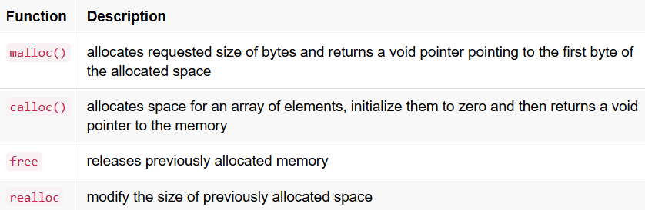
The process of allocating memory at runtime is known as Dynamic Memory Allocation(DMA). Library routines known as memory management functions are used for allocating and freeing memory during execution of a program. These functions are defined in stdlib.h header file.

Slide 5
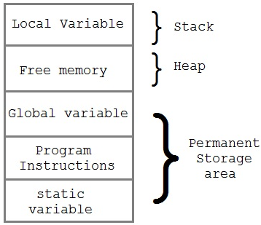
Memory Allocation Process
Global variables, static variables and program instructions get their memory in permanent storage area whereas local variables are stored in a memory
area called Stack.
The memory space between these two region is known as Heap area. This region is used for dynamic memory allocation during execution of the program.The size of heap keep changing.

Slide 6
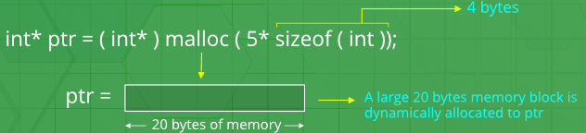
Malloc()
It stands for "memory allocation".
Used for allocating block of memory at runtime. This function reserves a block of memory of the given size and returns a pointer of type void. This means that we can assign it to any type of pointer using typecasting.
If it fails to allocate enough space as specified, it returns a NULL pointer.
Syntax: void * malloc(size);
Here size is the number of bytes of storage to be allocated.
Memory allocated by malloc() by default contain the garbage values.

Slide 7
Example
int *p;
p=(int*)malloc(n*sizeof(int));
Here,p is pointer of type integer(int).
int* tells to what type it will be pointing.
int tells that the malloc() function is type casted to return the address of integer variable.
n is the number of elements

Slide 8
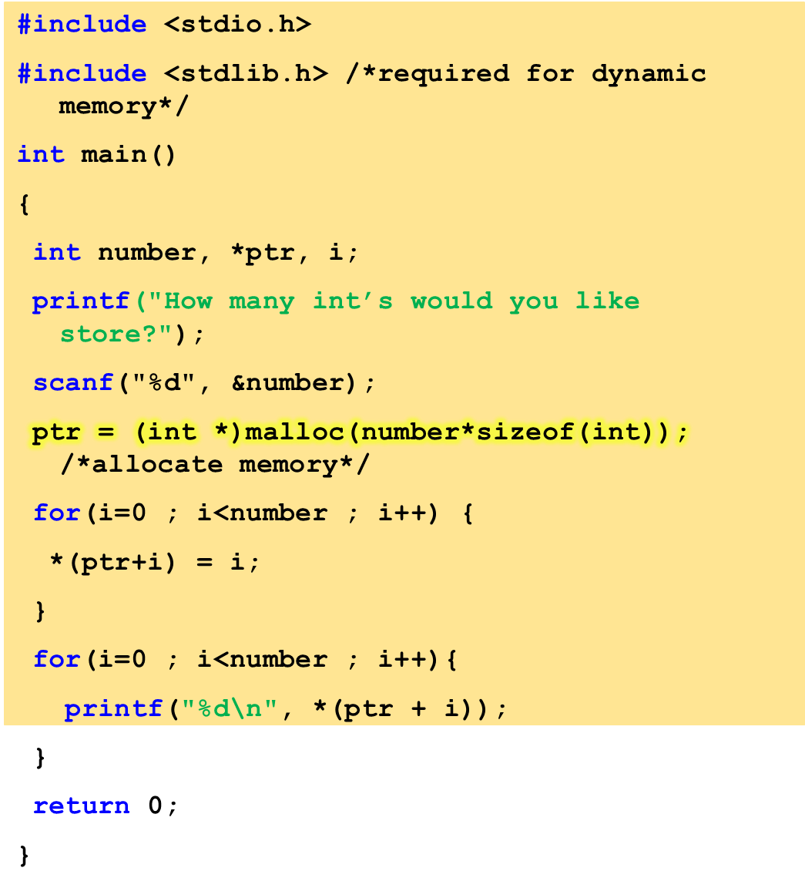
Program to allocate memory to integers.
OUTPUT:
How many int’s would you like store?
3
0
1
2

Slide 9
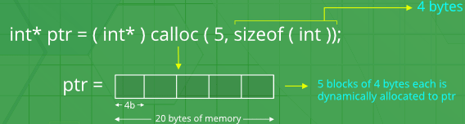
Calloc()
The name calloc stands for "Contiguous Allocation".
Used for allocating memory at runtime.
Normally used for allocating memory to derived data types such as arrays and structures. If it fails to allocate enough space as specified, it returns a NULL pointer.
Syntax:
void *calloc(size_t nitems, size_t size);
calloc is similar to malloc, but the main difference is that the values stored in the allocated memory space is zero by default. With malloc, the allocated memory could have any garbage value.
calloc() requires two arguments.
  The first is the number of variables you'd like to allocate memory for.
  The second is the size of each variable.

Slide 10
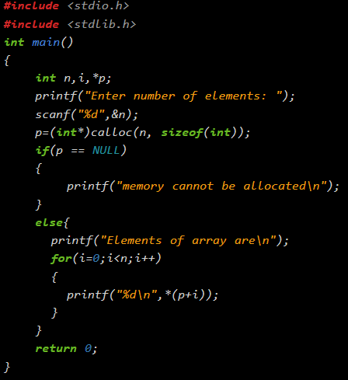
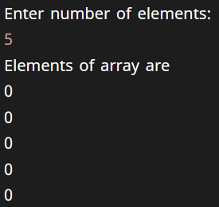
Example
OUTPUT:

Slide 11
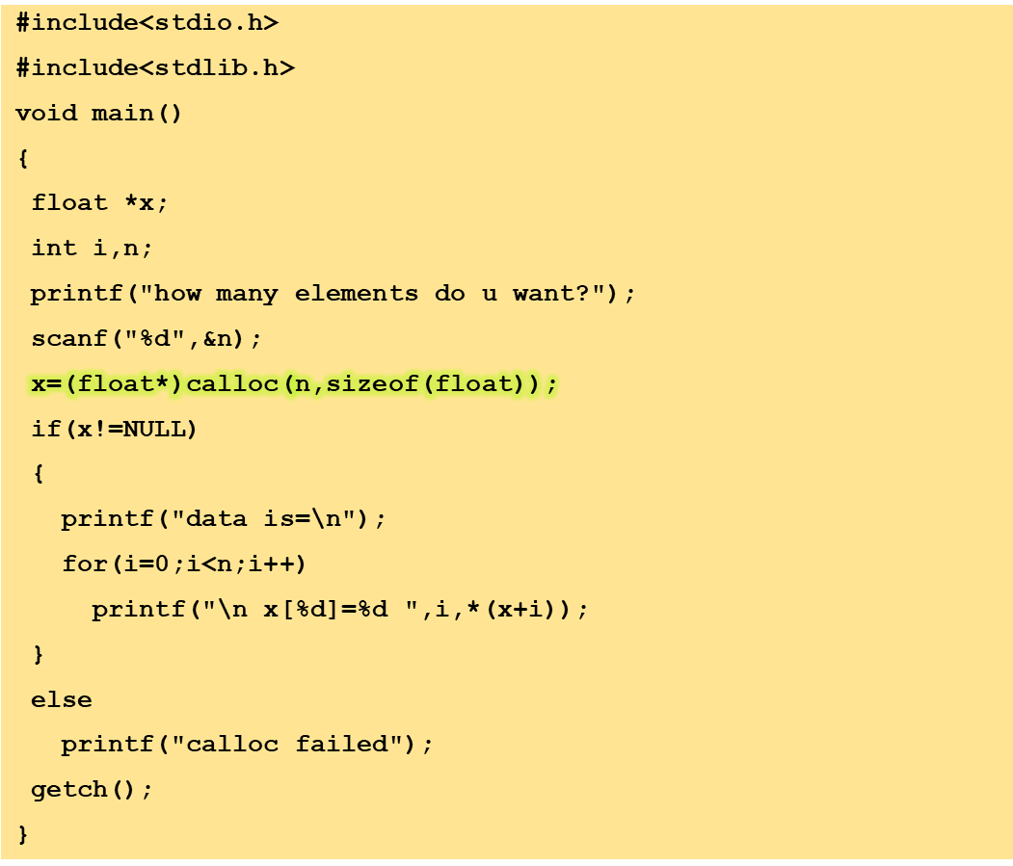
Program to show calloc() function

Slide 12
how many elements do u want 3
0
0
0

Slide 13
Difference between malloc() and calloc()
 | calloc() | malloc()
Function: | Allocates a region of memory large enough to hold "n elements" of "size" bytes each. | Allocates "size" bytes of memory.
Syntax: | void *calloc (number_of_blocks, size_in_bytes); | void *malloc (size_in_bytes);
No. of arguments: | 2 | 1
Contents of allocated memory: | The allocated region is initialized to zero. | The contents of allocated memory are not changed. i.e., the memory contains garbage values.
Return value: | void pointer (void *). If the allocation succeeds, a pointer to the block of memory is returned. | void pointer (void *). If the allocation succeeds, a pointer to the block of memory is returned.

Slide 14
Realloc()
If suppose we allocated more or less memory than required, then we can change the size of the previously allocated memory space using realloc.
Syntax: void *realloc(pointer, new-size);
realloc() takes two arguments.
  The first is the pointer referencing the memory.
  The second is the total number of bytes you want to reallocate.
Passing zero as the second argument is the equivalent of calling free.

Slide 15
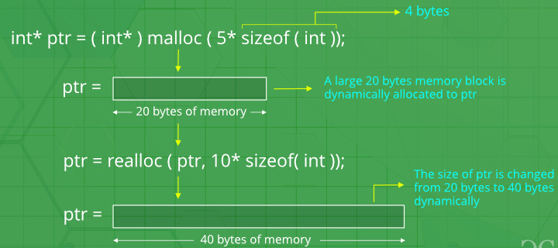
realloc()
If memory is allocated successfully, function realloc()returns a pointer to the first location of newly allocated block of memory which may be at same site or at new site and copy the contents from previous location to a new location if required , otherwise returns NULL.

Slide 16
Example
#include <stdio.h>
#include <stdlib.h>
#include <string.h>
int main()
{
char *p1;
int m1, m2;
m1 = 10; m2 = 20;
p1 = (char*)malloc(m1);
strcpy(p1, "Codesdope");
p1 = (char*)realloc(p1, m2);
strcat(p1, "Practice");
printf("%s\n", p1);
return 0;
}
OUTPUT:
CodesdopePractice

Slide 17
In the example, we declared a pointer p1 which will be used to dynamically allocate a memory space.
p1 = (char*)malloc(m1) - we assigned a memory space of 10 bytes which the pointer p1 is pointing to. We used (char*) to typecast the pointer returned by malloc to character.
strcpy(p1, "Codesdope") - This assigns a string value "Codesdope" to the memory which the pointer p1 is pointing to. Currently, the memory space is 10 bytes which can easily store the string "Codesdope", but what if now we want that memory space to store the string "CodesdopePractice"? For this, we need to expand the size of our memory space which we can easily do with realloc.
p1 = (char*)realloc(p1, m2) - This increases the size of the memory space (whose address is stored in p1) to 20 bytes(since the value of m2 is 20) which can easily store the string "CodesdopePractice".
strcat(p1, "Practice") - This adds the string "Practice" at the end of the string stored in the memory pointed by p1 i.e. "Codesdope". So now, the memory pointed by p1, now stores the string value "CodesdopePractice".

Slide 18
Free()
To deallocate or free the memory after the program finishes which was dynamically allocated in the program. It is advised to free the dynamically allocated memory after the program finishes, so that it becomes available for future use.
Syntax:
void free(pointer);

Slide 19
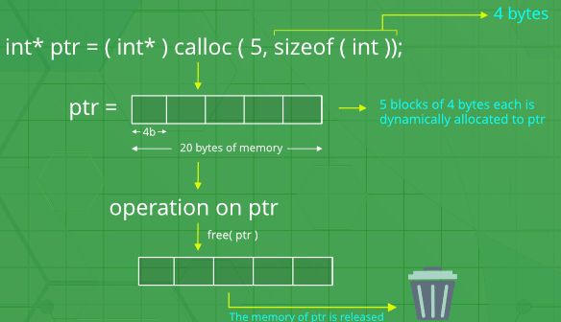
free()
The realloc() function can behave the same as free() function provided the second argument passed to realloc() is 0.
free(ptr);
which is equivalent to
realloc(ptr,0);

Slide 20
Memory Leak
A condition caused by a program that does not free up the extra memory it allocates.
It occurs when the dynamically allocated memory is no longer needed but it is not freed.
If we continuously keep on allocating the memory without freeing it for reuse, the entire heap storage will be exhausted.
In such circumstances, the memory allocation functions will start failing and program will start behaving unexpectedly

Slide 21
malloc() vs new(new in C++
NEW | MALLOC
calls constructor | doesnot calls constructors
It is an operator | It is a function
Returns exact data type | Returns void *
on failure, Throws | On failure, returns NULL
Memory allocated from free store | Memory allocated from heap
can be overridden | cannot be overridden
size is calculated by compiler | size is calculated manually

Slide 22
Next Class: Derived Types

